Slide 1
Chapter 7: Entity-Relationship Model

Slide 2
Design Phases
The initial phase of database design is to characterize fully the data needs of the prospective database users.
Next, the designer chooses a data model and, by applying the concepts of the chosen data model, translates these requirements into a conceptual schema of the database.
A fully developed conceptual schema also indicates the functional requirements of the enterprise. In a “specification of functional requirements”, users describe the kinds of operations (or transactions) that will be performed on the data.

Slide 3
Design Phases (Cont.)
The process of moving from an abstract data model to the implementation of the database proceeds in two final design phases.
Logical Design – Deciding on the database schema. Database design requires that we find a “good” collection of relation schemas.
  Business decision – What attributes should we record in the database?
  Computer Science decision – What relation schemas should we have and how should the attributes be distributed among the various relation schemas?
Physical Design – Deciding on the physical layout of the database

Slide 4
Design Approaches
Entity Relationship Model (covered in this chapter)
  Models an enterprise as a collection of entities and relationships
    Entity: a “thing” or “object” in the enterprise that is distinguishable from other objects
      Described by a set of attributes
    Relationship: an association among several entities
  Represented diagrammatically by an entity-relationship diagram:
Normalization Theory (Chapter 8)
  Formalize what designs are bad, and test for them

Slide 5
Outline of the ER Model

Slide 6
ER model -- Database Modeling
The ER data model was developed to facilitate database design by allowing specification of an enterprise schema that represents the overall logical structure of a database.
The ER model is very useful in mapping the meanings and interactions of real-world enterprises onto a conceptual schema. Because of this usefulness, many database-design tools draw on concepts from the ER model.
The ER data model employs three basic concepts:
  entity sets,
  relationship sets,
  attributes.
The ER model also has an associated diagrammatic representation, the ER diagram, which can express the overall logical structure of a database graphically.

Slide 7
Entity Sets
An entity is an object that exists and is distinguishable from other objects.
  Example: specific person, company, event, plant
An entity set is a set of entities of the same type that share the same properties.
  Example: set of all persons, companies, trees, holidays
An entity is represented by a set of attributes; i.e., descriptive properties possessed by all members of an entity set.
  Example:
  instructor = (ID, name, street, city, salary )
  course= (course_id, title, credits)
A subset of the attributes form a primary key of the entity set; i.e., uniquely identifiying each member of the set.

Slide 8

Entity Sets -- instructor and student
instructor_ID instructor_name student-ID student_name

Slide 9

ER Diagram: Entity Sets
Entities can be represented graphically as follows:
  Rectangles represent entity sets.
  Attributes listed inside entity rectangle
  Underline indicates primary key attributes

Slide 10
Relationship Sets
A relationship is an association among several entities
Example:
44553 (Peltier) advisor 22222 (Einstein)
student entity relationship set instructor entity
A relationship set is a mathematical relation among n ≥ 2 entities, each taken from entity sets
{(e₁, e₂, … e_{n}) | e₁ ∈ E₁, e₂ ∈ E₂, …, e_{n} ∈ E_{n}}
where (e₁, e₂, …, e_{n}) is a relationship
  Example:
  (44553,22222) ∈ advisor

Slide 11

Relationship Set advisor

Slide 12

ER Diagram: Relationship Sets
Diamonds represent relationship sets.

Slide 13

Relationship Sets (Cont.)
An attribute can also be associated with a relationship set i.e. descriptive attribute.
For instance, the advisor relationship set between entity sets instructor and student may have the attribute date which tracks when the student started being associated with the advisor

Slide 14

ER Diagram: Relationship Sets with Attributes

Slide 15
Degree of a Relationship Set
binary relationship
  involve two entity sets (or degree two).
  most relationship sets in a database system are binary.
Relationships between more than two entity sets are rare. Most relationships are binary.
Example: students work on research projects under the guidance of an instructor.
  relationship proj_guide is a ternary relationship between instructor, student, and project

Slide 16
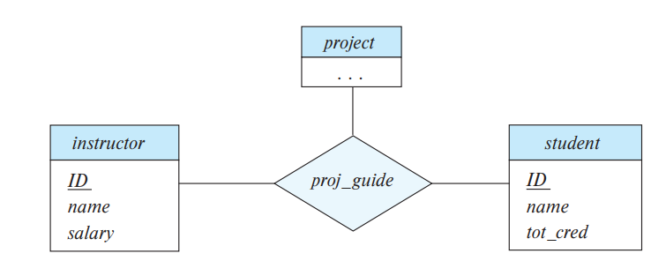
E-R diagram with a ternary relationship

Slide 17

Roles
Entity sets of a relationship need not be distinct
  Each occurrence of an entity set plays a “role” in the relationship
The labels “course_id” and “prereq_id” are called roles.

Slide 18
Complex Attributes
Attribute types:
  Simple and composite attributes.
  Single-valued and multivalued attributes
    Example: multivalued attribute: phone_numbers
  Derived attributes
    Can be computed from other attributes
    Example: age, given date_of_birth
Domain – the set of permitted values for each attribute

Slide 19

Composite Attributes

Slide 20

Notation to Express Entity with Complex Attributes

Slide 21
Mapping Cardinality Constraints
Express the number of entities to which another entity can be associated via a relationship set.
Most useful in describing binary relationship sets.
For a binary relationship set the mapping cardinality must be one of the following types:
  One to one
  One to many
  Many to one
  Many to many

Slide 22

Mapping Cardinalities
One to one
One to many
Note: Some elements in A and B may not be mapped to any
elements in the other set

Slide 23

Mapping Cardinalities
Many to one
Many to many
Note: Some elements in A and B may not be mapped to any
elements in the other set

Slide 24
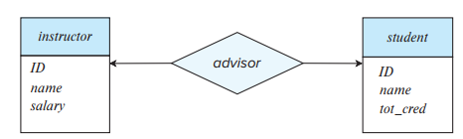
One-to-one Relationship
one-to-one relationship between an instructor and a student
  an instructor is associated with at most one student via advisor
  a student is associated with at most one instructor via advisor,

Slide 25

One-to-Many Relationship
one-to-many relationship between an instructor and a student
  an instructor is associated with several (including 0) students via advisor
  a student is associated with at most one instructor via advisor,

Slide 26
Many-to-One Relationships
In a many-to-one relationship between an instructor and a student,
  an instructor is associated with at most one student via advisor,
  and a student is associated with several (including 0) instructors via advisor

Slide 27
Many-to-Many Relationship
An instructor is associated with several (possibly 0) students via advisor
A student is associated with several (possibly 0) instructors via advisor

